Slide 1
Southside Surf Shop
Artistic work on the board log

Slide 2

BRENDA MICKENS- 1000$

Slide 3

RANDALL LINDEN-500$

Slide 4
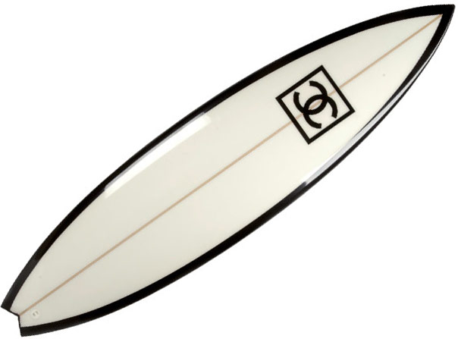
ROCHELLE TRAY-500

Slide 5
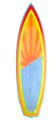
DAVID RAMSEY-475

Slide 6
NAMES OF THE ARTIST
New Board Logo Artists
First Name | Last Name | Commission
Janet | Kendall | $ 550
Tally | Stroud | $ 700
Remi | Ross | $ 575
Brenda | Mickens | $ 1,000
Randall | Linden | $ 500
Rochelle | Tray | $ 500
David | Ramsey | $ 475
Rhonda | Anderson | $ 870
Rick | Hines | $ 930
Andy | Massie | $ 780
Nicholas | McCray | $ 600
Mike | Venable | $ 850
Marilyn | Jones | $ 600
Nancy | Jackson | $ 770
Dasiy | Malcolm | $ 690
Ashton | Linder | $ 1,050
Dennis | Cavern | $ 890

